Slide 1



MyTown Microgrid Heyfield
Prefeasibility Study and
Community Engagement Plan
Prepared for Heyfield Community Resource Centre by UTS Institute for Sustainable Futures
Project was funded by
June 2020

Slide 2



Research Team
    Dr. Franziska Mey, Senior Research Consultant at Institute for Sustainable Futures
    Dr. Scott Dwyer, Research Principal at the Institute for Sustainable Futures
    Dr. Carmel Anderson, Consultant
    Julie Bryer, Heyfield Community Research Centre
Citation
  Mey, F., Dwyer, S., Anderson, C., Bryer, J. (2020): MyTown Microgrid Heyfield – Prefeasibility study and community engagement plan. Sydney. Heyfield.
  About the authors
  The Institute for Sustainable Futures (ISF) is an interdisciplinary research and consulting organisation at the University of Technology Sydney. ISF has been setting global benchmarks since 1997 in helping governments, organisations, businesses and communities achieve change towards sustainable futures.
  We utilise a unique combination of skills and perspectives to offer long term sustainable solutions that protect and enhance the environment, human wellbeing and social equity.
  Heyfield Community Resource Centre (HCRC) is the heart of the community. They run short courses, classes and social activities to help people learn new skills and make new connections. They also offer occasional childcare, a lawn mowing service and run a Men's Shed. New projects include a community garden, sustainability initiatives, a pop-up craft shop and plant nursery.

Slide 3
List of Content
Introduction
01
Heyfield’s Renewable Energy Vision
03
4
19
Community Engagement Strategy
Prefeasibility Study: Context and Areas of Work
04
02
7
23
2.1
4.1
Community Energy
9
Stakeholder Mapping
28
4.2
2.2
Engagement Activities
Regional Context
12
32
4.3
2.3
Communication Strategy
Status of Renewable Energy in Heyfield
34
14
4.4
Opportunities and Challenges
36
05
Summary and next steps
38
Notes:
Fran
List of content to get an overview
There are three main parts
Our prefeasibility report and some context information such as the current stage of renewable energy deployment in Hyefield and the region
Second part is the renewable energy vision of the community based on the community survey and interviews
Thirdly the community engagement strategy for the next stage of this project which includes stakeholder mapping community engagement activiites a coms strategy and opportunities and challenges
So this is the outline, for the sake of time, we won’t go into detail in all parts, but I like to present a couple of slides on the vision and the engagement plan for your information and feedback

Slide 4
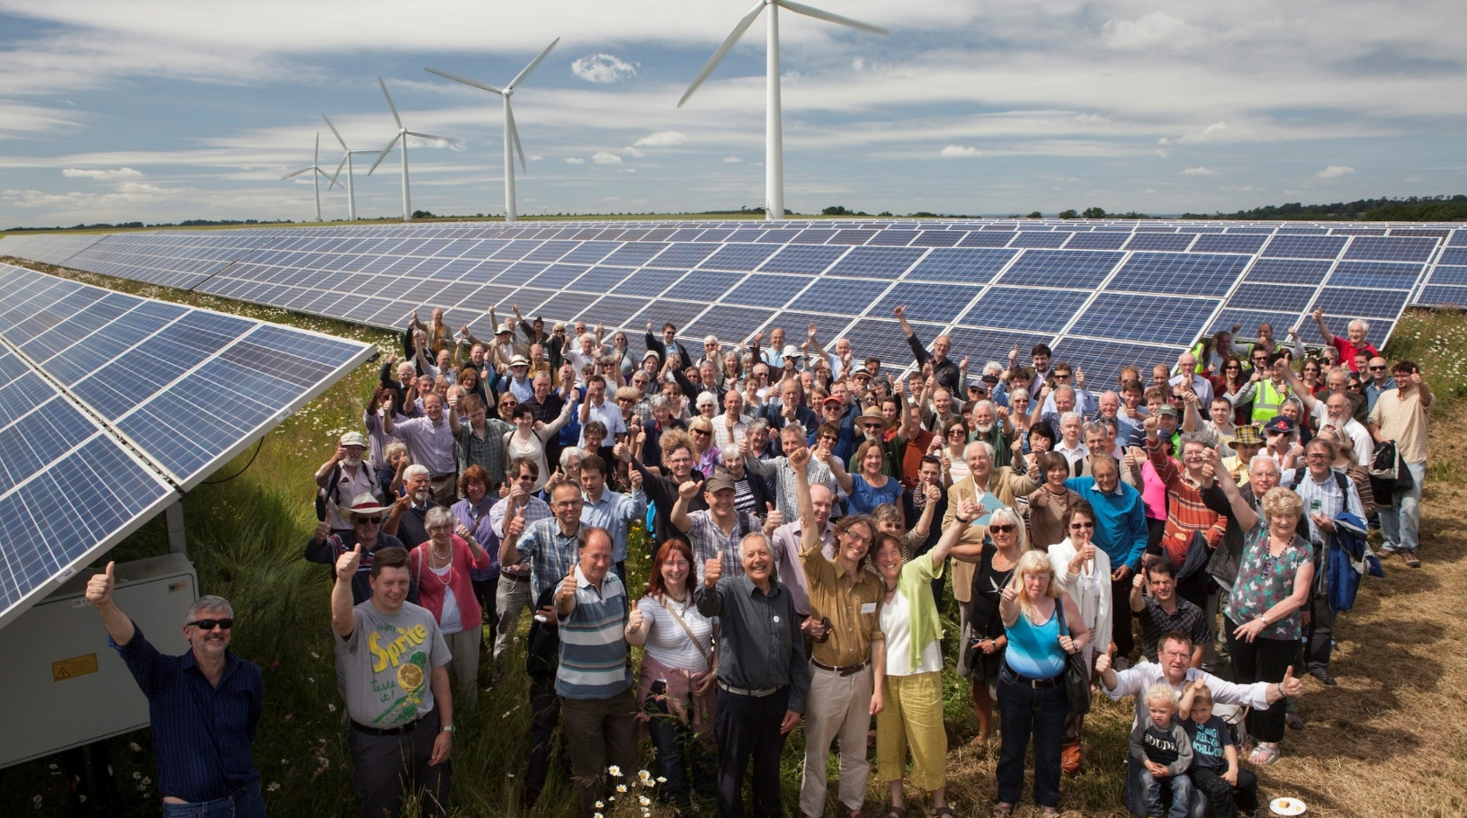
1. Introduction
Heyfield is uniquely placed to develop a local community microgrid
More and more communities are taking control of their own energy supply in Australia. Spurred by new clean technology options, these communities are part of a global movement changing the way electricity is generated, transmitted, stored and used.¹ Indeed localised solutions empower communities to become resilient and adapt to crisis situation.²
The recent events demonstrate that this is more urgent than ever. The devastating bushfire crisis last summer has made climate change become a cruel reality for many in our country, building up further momentum for change.³ The current health crisis appears as another stepping stone with a wide range of business groups are advocating for Covid recovery packages as an historic opportunity to build low-carbon economies that are more sustainable and resilient.⁴
Regions like the Latrobe Valley have traditionally been at the centre of Australia’s energy industry. Coal mining, electricity generation and an extensive electricity transmission network to export electricity to other regions of the state and beyond shaped the regions profile and understanding. Today, Latrobe Valley hosts three operating coal-fired power stations, yet, coal power stations are reaching the end of their lifetime as more renewable energy comes on stream.
The transition to a cleaner, more decentralised energy system is accelerating. One of the key drivers is the reduction in the cost of solar and wind energy. The Reserve Bank of Australia found that solar and wind energy is now cheaper than wholesale electricity through the National Electricity Market. ⁵ For some communities it could be even cheaper to generate and distribute their own power supply in a localised energy system. A local energy system could come in many forms, such as solar panels connected to a micro-grid that can be islanded when transmission or distribution lines – the poles and wires – are threatened or damaged.

Slide 5
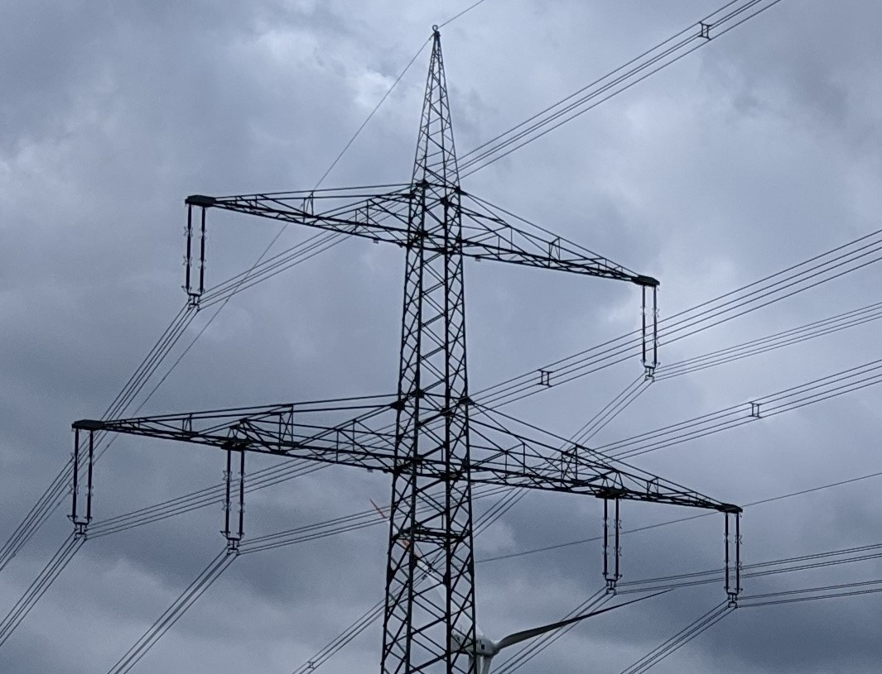
New regulations make it easier to set up microgrids were they represent a cheaper alternative to the ongoing maintenance of poles and wires ⁶
Heyfield is an excellent candidate for a community microgrid. The town distinguishes itself through its high penetration of rooftop solar systems, its placement at the edge of the grid and a very active and engaged community. These are important prerequisites for exploring the economic viability and the social-institutional requirements to implement a local microgrid. Indeed the community needs have to take central focus in the planning and implementation of a microgrid.
The Heyfield Community Resource Centre (HCRC) was funded by the Latrobe Valley Authority to commission a microgrid pre-feasibility study. The study would provide a better understanding of the community’s views for how it wishes to generate and use energy in the future. It would also lead to the development of a community engagement plan that would guide future activities on this topic. The Institute for Sustainable Futures (ISF) was commissioned by HCRC to undertake the prefeasibility with its support.
Structure of this document
The purpose of this document is to present a summary of findings from the pre-feasibility study.
It is structured into three key sections:
Prefeasibility Report: an overview of the context relating to community energy, microgrids and the status of renewable energy in the region.
Vision for a Renewable Energy Future: results and findings of the community survey.
Community Engagement Plan: mapping out actions and methods to involve and empower the local community in the next stage of the project development
This Pre-feasibility Study is a starting point for a local discussion and engagement to explore the opportunities of implementing a community microgrid in Heyfield.

Slide 6
Prefeasibility Study Report
My
Town
Microgrid

Slide 7
2. Pre-feasibility Study: Context and Areas of Work
Heyfield is an ideal location to develop a way to design and implement a more sustainable, equitable, local energy model
Heyfield Community Research Centre (HCRC), the Institute for Sustainable Futures (ISF) and Wattwatchers Digital Energy Pty have been driving the concept of a community and data driven microgrid concept in Heyfield for a number of years.
Purpose of this Study
From February to May 2020 the project team conducted a Prefeasibility Study, which aimed at better understanding the community appetite, profile and broader context for a microgrid installation.
The prefeasibility study has been guided by four objectives:
Inform the community about the opportunity of a local microgrid and how it could work in the context of Heyfield.
Explore what the community wants when it comes to its energy supply and how it wants to use and generate electricity over the coming years.
Listen to the community’s ideas and concerns and ensure it has its say and has a chance to ask questions and input to this process.
Define how the community wishes to engage in a proposed project where the feasibility of a microgrid for the town of Heyfield is explored
Methods
This project combined desktop research and empirical data analysis drawing on 8 interviews and a community survey which received 77 responses. It did not cover any technical elements such as assessing peoples’ energy use patterns, or deciding what technologies will be installed in homes or businesses. The technology focussed partners will be key in the next stage of the project development.
While the project team has engaged with local stakeholders to gauge the interest of the community in a local microgrid, it also determine pathways for community engagement. The Prefeasibility Study comprised four areas of work:
Background research to understand the context of Heyfield
Community survey distributed through online and street engagement to gauge local interest in the project idea
Webinar to inform and consult the community and ultimately engage selected members of the community in project
Community Engagement Plan to map out the engagement and communication methods for delivering the Feasibility Study for the MyTown Microgrid project

Slide 8
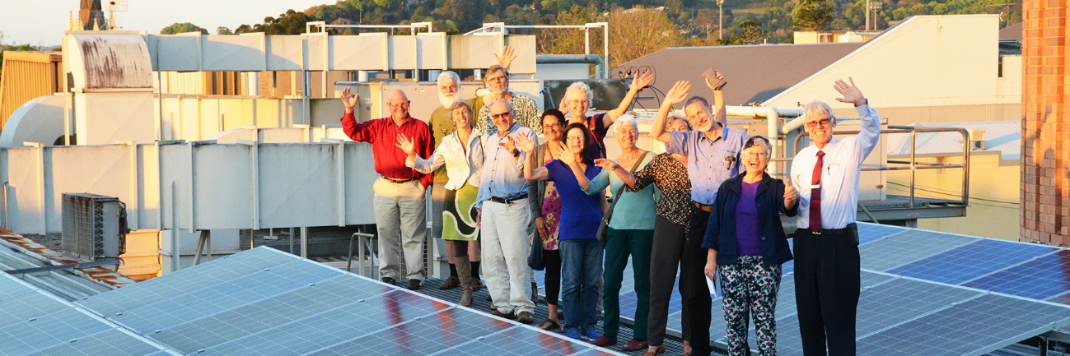
Covid-19 crisis has demonstrated the need to cope with change and disruption
The Coronavirus COVID-19 pandemic and related ongoing health and containment measures have caused project activity alterations. The planned community townhall event and community workshops were postponed and instead virtual tools for community engagement were used. Nonetheless it remains our ideal to hold community engagement activities in person and will do so in the next stage of the project as soon as restrictions are lifted.
The ultimate vision of MyTown Microgrid is to enable the community of Heyfield to understand, design and implement a local renewable energy system – a local microgrid – through bringing together progressive industry, community and research partners and building on Heyfield’s local economic strengths and tackling evolving regulatory challenges.

Slide 9
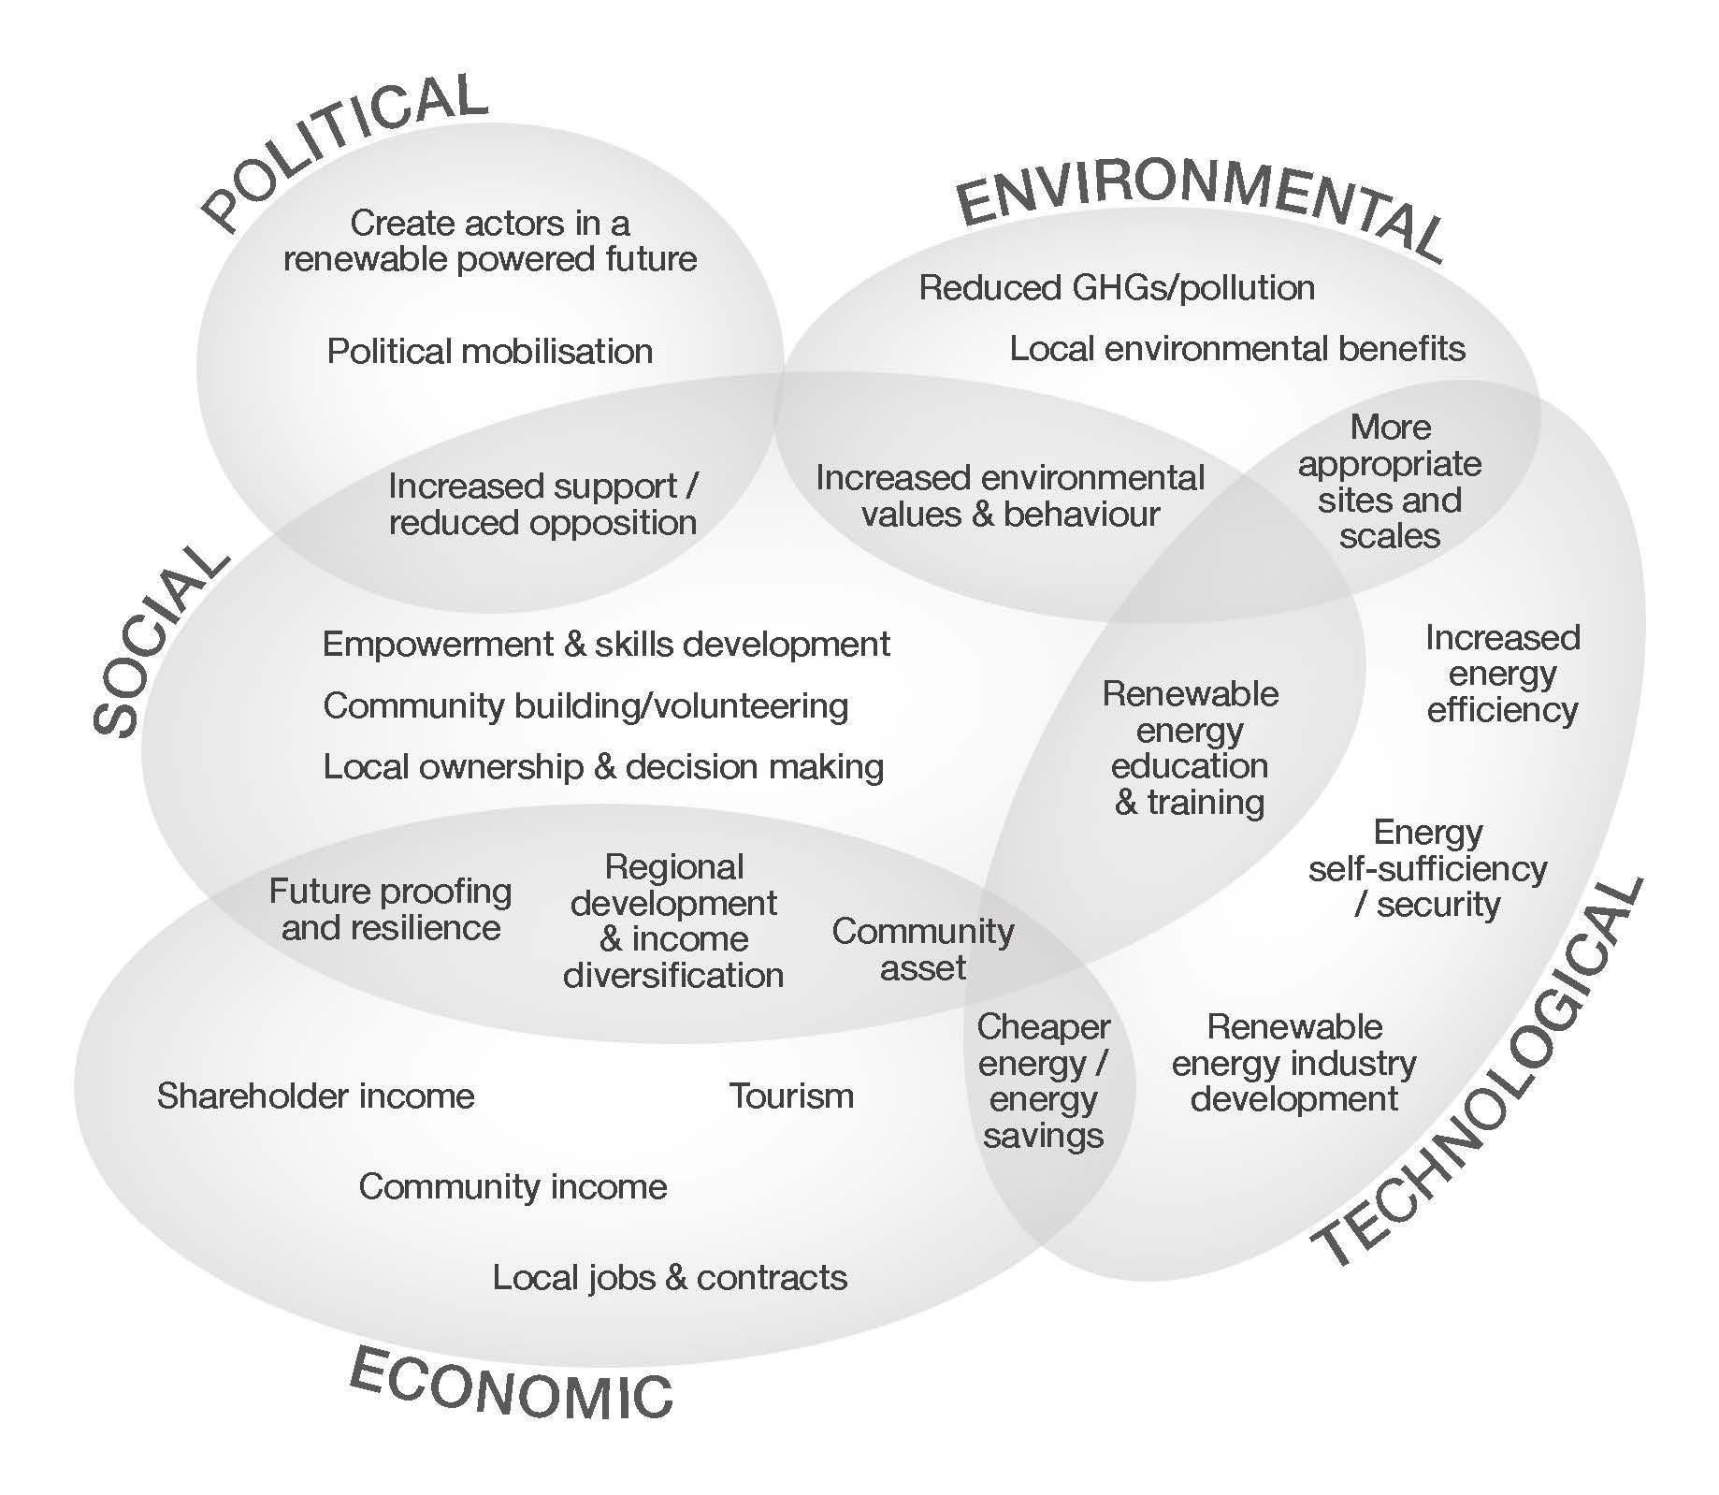
2.1 Community Energy
Heyfield is part of a growing national and international movement of community energy
The Heyfield community has demonstrated great enthusiasm and engagement for sustainability initiatives in the past. Exploring a community energy project is a promising next step to progress locally driven climate action. Heyfield is not alone. There are more than 110 community energy groups in Australia which are changing the way energy has been traditionally sourced, used and distributed.⁷
The Coalition for Community Energy defines community energy as: “The wide range of ways that communities can develop, deliver and benefit from sustainable energy.” ⁸ Recent examples of community energy projects have included:
Communities fundraising to put solar on a community building, for example Adelaide-based CORENA;
People investing their hard-earned cash in a solar array on the local brewery or dairy, as was the case with Pingala in inner-Sydney and Repower Shoalhaven on the south coast of NSW;
A community-owned solar or wind farm at the edge of town, such as Hepburn Wind in Vic and soon Solar Share in the ACT;
Community initiatives that support grid stability and provide alternatives to conventional network upgrades, so called microgrids or embedded networks.
A key characteristic of community energy projects in Australia is the deviation from the norm of conventional power production, which has been large-scale, carbon intensive, centralised and mono- or oligopoly owned either by the state or large corporate bodies. A wide range of benefits has been demonstrated to flow from community renewable energy projects, due to their unique ability to involve people in renewable energy generation. The range of benefits is outlined in Figure 1 below.
Figure 1: Motivations and potential benefits of community energy
Source: Hicks and Ison, 2010 and 2019

Slide 10












Community Microgrids
In one form or another, microgrids have been in the energy service toolbox for 30 years ⁹
Microgrids or standalone power system can be defined as a group of homes and businesses who use, generate, and share electricity. It may be able to function both as part of the grid, and autonomously. It will typically comprise solar PV system or small wind farms to generate the majority of the electricity required, a battery system to store the electricity, a backup generator (typically diesel-powered), and power electronics to convert energy and manage the system.
Driven by local climate targets, communities have started to embrace the concept and adopt the technology aspiring for sustainability, reliability, resilience, and cost predictability. Indeed, microgrids have become the next level of community energy contributing to profound changes in the way entire communities’ source, use and distribute electricity. These changes can be described as part of a “deep transition” where socio-technical systems alter our traditional centralised energy regime.¹⁰
These systems can combine all the above mentioned benefits of community energy projects (Figure 1 on the previous page) while offering solutions at a community scale. Added value comes from the improvement in sustainability through the additional renewable energy deployment, reduced use of the main grid and efficiency gains.¹¹ The recent ARENA funded study ‘Latrobe Valley Microgrid Feasibility Assessment’ confirmed that consumers and especially prosumers can benefit from participating in a local microgrid, by unlocking additional value for solar PV owners, ultimately reducing overall supply costs to all consumers.¹²
The importance of a reliable and resilient energy supply have been demonstrated across many different parts of the country when extreme weather or natural disasters have occurred.
Microgrid

Slide 11
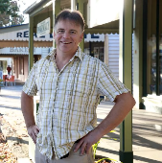
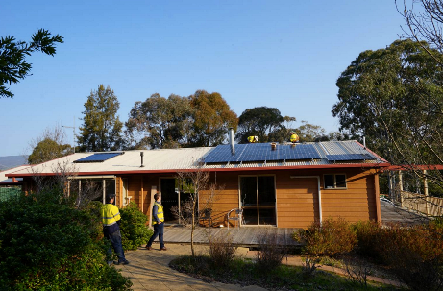
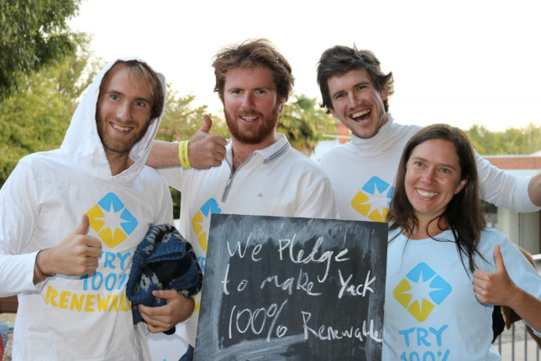
Benefits of Community Microgrids
Other communities in Australia demonstrate the great benefits of community microgrids
Microgrids can particularly offer solutions for communities which are remote, on the edge of the grid or are surrounded by difficult terrain prone to bushfires and other natural disasters (flooding and storms). These systems can help communities become more resilient in the preparation for, with-standing of, and recovery from major natural disasters and/or lengthy grid outages.
Continuing to serve a community during and after a major bushfire, storm or flooding event provides great value for the community and local businesses. For example, minimising interruption of essential services, business operations, and risk of health hazards.
Microgrids may be an important step to ensure the future resilience of energy supply for many of communities in Australia, while it can be a cheaper solution than maintaining a continuous and inflexible connection to the main grid.
Potential benefits
Cost effective alternative to upgrading/replacing grid.
More resilient in wake of extreme events.
Benefits sharing among participants.
Improve the operation and stability of the main grid.
Supply clean, affordable, reliable energy.
Example: Yackandandah’s community driven microgrid
The partnership between community energy group Totally Renewable Yackandandah, local utility Ausnet Service, and Mondo Power is highly relevant example of community action for locally owned and distributed energy.
Yackandandah located in Indigo Shire is in the process of creating a series of community mini-grids to achieve 100% renewable energy by 2022. The mini grid systems enable groups of houses within the town, to generate, store and ultimately share electricity.
Currently, Totally Renewable Yackandandah is looking into upgrading these microgrids so they are capable of operating separately from the larger electricity network (islanding) and thus helping to ensure energy security and reliability in town when the larger grid is disrupted or blackout. This will make Yackandandah more energy resilient when centralised power stations trip and as natural hazards such as bush fires and storms become more frequent and severe due to worsening climate change.¹¹

Slide 12
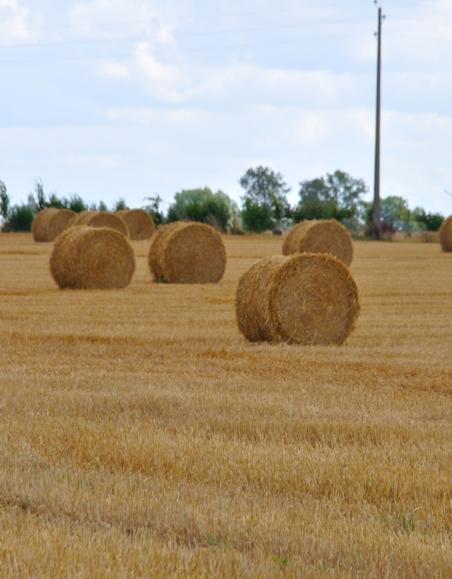
2.2 Regional Context
The Heyfield region is known for its high agricultural, natural resources, significant landscape and heritage values.
Described as a “field of waving corn”,¹³ the little town of Heyfield is situated in Central Gippsland/ Victoria surrounded by fertile agricultural land, forests and abundant water supplies. At its doorstep are Lake Glenmaggie a popular camping and water sport destination and the mountains of the Great Dividing Range further north. The town is part of Wellington Shire, approx. 200 km east of Melbourne. The Shire extends from Victoria’s High Country through rich irrigated flats, productive grazing land, the Gippsland Lakes and Wetlands to the Ninety Mile Beach and Bass Strait. The Latrobe Valley is to the south-west of the town.
“Gunai/Kurnai” is the name of first people which inhabited the Gippsland region for at least 18,000 years before the European settlement. Their leadership in sustainability knowledge and practices has only recently begun to receive widespread recognition.
Gippsland has a long history of energy generation and coal mining making valuable contributions to the local region, the state and the country as a whole. When coal was discovered in the mid 19th century the Latrobe Valley became the centre of the energy industry and the energy powerhouse of Victoria with an extensive electricity transmission network supplying other areas of the state and beyond.

Slide 13
Socio-Demographics
Heyfield is home to Australia's largest hard wood saw miller, timber processer and largest manufacturer of hard wood timber products, employing more than 250 workers.
Heyfield has a population of 1993 people and is part of the third largest municipality in Victoria, Wellington Shire.¹⁴
Heyfield’s economy has historically been based around timber, gold mining and an agricultural industry, especially vegetable and dairy farming (hinterland), and this remains the case today. However, the proximity of Heyfield to larger regional centres, such as Traralgon and Sale, has reduced the importance of the township as a focus for agricultural supplies and services in recent decades.
Heyfield supports 820 jobs with major employers are the sawmill, the hospital, supermarkets, dairy cattle farming and primary education.¹⁵ Some community members work also in the Latrobe Valley’s energy industry – coal mines and power stations.
The town takes pride having fundraised for and owning a number of public services such as the local hospital, Laurina Lodge - the care centre, the kindergarten and local basketball stadium. The local branch of Bendigo Bank was instrumental supporting the local community.¹⁶
The town has an average proportion of the local workforce in full time employment (57.3 per cent in full time, 31.1 per cent in part time), and a lower proportion unemployed than the state average.¹⁷
The largest business in Heyfield is the Australian Sustainable Hardwoods (ASH) timber mill supplying hardwoods to manufacture products such as furniture, windows, doors, staircases in Victoria. ¹⁸
The broader Wellington Shire area hosts a wide variety of industry and business also contributing to the local economy including; mining, offshore oil and gas extraction, primary production and agriculture, tourism and service industries, retail, healthcare, education and community services. Agricultural land in Wellington Shire offers some of the best conditions in the state, with Gippsland fast developing a name as Victoria’s Food Bowl.
The town has lower household income and lower levels of minimum education compared with the state average. Both personal ($499) and household ($922) income per week are below Victorian average. There is lower proportion of people holding formal qualifications (Bachelor or higher degree; Advanced Diploma or Diploma; or vocational qualifications) in Heyfield compared with the state average.¹⁹
The last state election saw strong support for the National Party with more than 60 per cent of the local votes, the remaining were split between the Australian Labor Party (16.88 per cent) and Shooters, Fishers and Farmers (9.45 per cent), United Australia Party (4.77 per cent and the Greens (3.94 per cent).²⁰

Slide 14
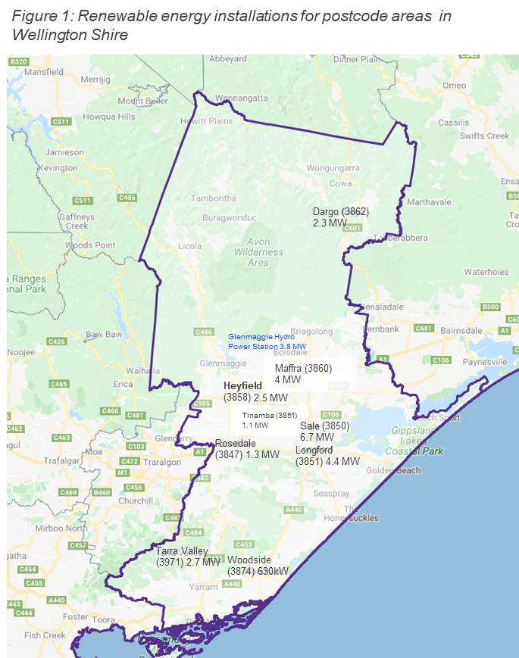
2.3 Status of Renewable Energy
Heyfield has one of Australia’s highest penetration of solar PV at town level while the community is very supportive of renewable energy.
Wellington Shire has been installing renewable energy for some time. The local government area has up to 25.3 MW existing renewable energy capacity consisting mainly of rooftop solar. ²¹ The Glenmaggie Hydro Power Station is a medium sized installation with 3.8 MW. There are currently no large-scale wind farms nor solar farms yet. However the region has great potential with access to world class renewable energy resources with wind speeds over 7.58 metres per second and 3.8 to 4.8 kWh of daily solar PV exposure.²² Solar and wind farms are likely to play a greater role in Wellington Shire, alongside continuing growth of rooftop PV. In addition, the agriculture sector provides scope for bioenergy deployment in particular waste streams (dairy effluent and manure, crop waste etc.).
Heyfield’s community loves solar. Solar panels cover almost 1/3 of all houses in the postcode area (3858) with more than 460 rooftop installations and a total capacity of 2.5 MW.²³ Around half of businesses have solar installed in the town based on discussions held as part of this research. The high penetration of solar can be attributed to a great awareness of sustainability issues. This goes back to the home-grown sustainability program that helped individuals to adopt sustainable practices in daily life.
The figure below shows the current renewable energy installations across Wellington Shire. The numbers indicate installed megawatts of small scale solar generation for the postcode areas (in brackets).
Renewable energy installations for postcode areas in Wellington Shire

Slide 15
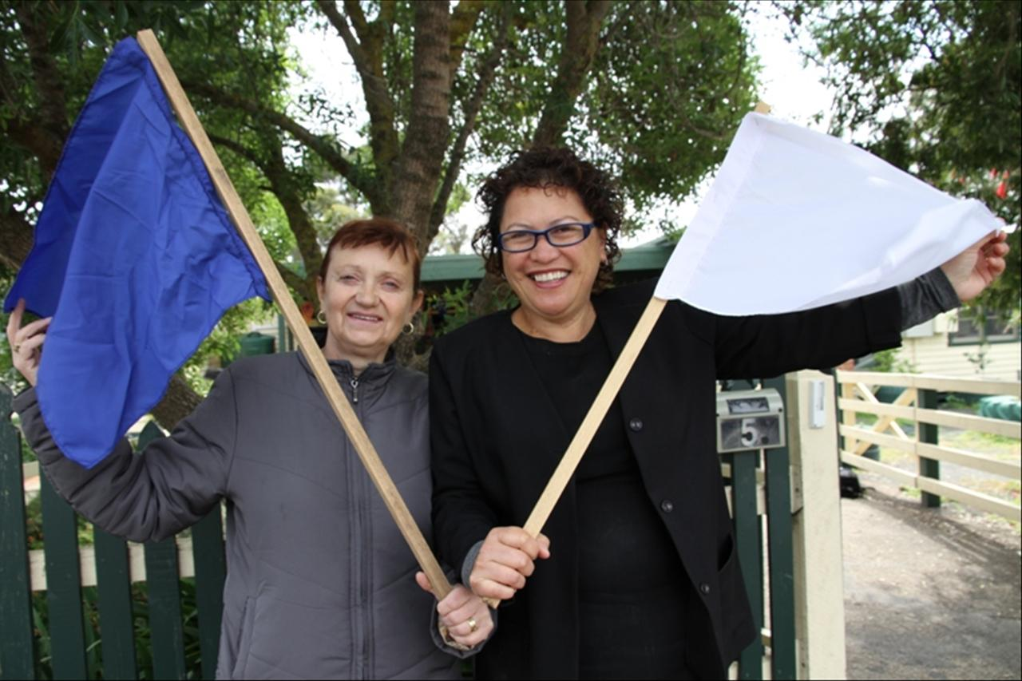
Heyfield Community Resource Centre Sustainability Initiatives
HCRC was established in 1988 and is the leading force of numerous local sustainability initiatives, activities and services for Heyfield and surrounding districts.
Heyfield’s Sustainable Smart Town Program
The Heyfield Community Resource Centre (HCRC) initiated and led the Sustainable Smart Town program. The Centre engaged almost half of Heyfield’s households in the three stage program. It involved bulk purchase scheme for solar panels; flag installations for behaviour change; posting coloured stickers on letter boxes to acknowledge participation in the program.
The flag system was crucial component to the program’s adoption, demonstrating the locals adoption of water, energy and waste efficiency measures: a white for taking first steps in the program, a blue flag for making their home or business more sustainable, and a green flag recognises homes and businesses that have significantly reduced their carbon footprint. The great success of this initiative was recognised with the World Environment Day Award from the United Nations Association of Australia in 2011.
The HCRC is extremely proud of the awards they have won over the years and are very appreciative of the help from their many volunteers and the encouragement they receive from the Heyfield community.
HCRC Awards
ACFE Learn Local Legend - Gippsland Region 2018
Awarded Australia's Strongest and Most Resilient Community 2017
Finalist Wellington Shire Council Community Group of the Year 2017
World Environment Day Awards 2011
Finalist 2011 State Premiers Award
Prime Super winner 2011
Pam Keating Tidy Town winner 2011

Slide 16

Renewable Energy Generation
One third of all houses in the postcode area and more than 60% of all buildings in town are covered by solar panels. ²⁴
Small-Scale Generation
Heyfield has demonstrated its great engagement in renewable energy by the fact that one third of all houses of the postcode area (3858) and half of businesses in the town (estimate of HCRC) have installed solar panels. The bulk buy scheme initiated by the HCRC in the early 2010 contributed significantly to the take up of household systems. This results in a total installed capacity of 2.5 MW of small rooftop installations. In addition, there are also 250 solar hot water installations across Heyfield area. ²⁵
Of the local businesses that have rooftop solar, small scale installations can be found on the roof of the Railway Hotel Heyfield, Larina Lodge, IGA, the local DELWP office, Bendigo Bank and the Farming Company. Major community buildings also have installations, such as the community centre, school, Post Office and the Community Wetland Centre.
Medium-Scale Generation
Medium-scale generation can be defined as installations over 100kW and under 10MW. There is currently only one medium size renewable energy project with the Glenmaggie Hydro Power Station built and owned by Pacific Hydro in the region. The major purpose of that scheme is to supply irrigation water for the surrounding agricultural land.
In the last ten years, there is a growing movement of community organisations, indigenous organisations, small- and medium-sized businesses, and local governments developing, owning and operating renewable energy projects at scales lager than is possible at the household level.
Indeed an increasing number of community energy projects emerged in neighbouring councils and districts, such as the Energy Innovative Cooperative, the Latrobe Valley Community Power Hub and Totally Renewable Phillip Island.
There is no known community owned energy project in Wellington Shire yet. However, our initial community survey revealed great appetite for locally generated renewable energy, its benefits and opportunities for Heyfield.
Notes:
(Clean Energy Regulator 2020)

Slide 17
Renewable Energy Generation and Network Infrastructure
There are a number of projects and plans for large-scale solar, offshore wind and battery installations underway
Large Scale Renewable Energy
At present Wellington Shire has no large-scale renewable energy generation facilities. However there are a number of projects and plans for large-scale solar, offshore wind and battery installations under way.
Melbourne-based company Solis RE have started planning for a Gippsland Renewable Energy Park to host more than 250MW of solar with 250MWh of batteries. The project, conservatively estimated to cost $1.28 billion and set to create about 1200 local jobs during the construction phase, will roll out across three sites. ²⁶
The first Australian offshore wind farm is being considered off the south coast in Gippsland. The proposed Star of the South project involves building wind turbines out at sea with cables and substations connecting power to existing infrastructure in the Latrobe Valley. The project is currently in the feasibility stage and has featured initial stakeholder and community engagement.
Energy Network Infrastructure
Australia has the largest interconnected electricity network in the world. There are two main electricity networks (National Electricity Market in South-East Australia and West Australian Interconnected System) and many islanded grids in remote locations. The network comprises two key components: transmission lines that transmit electricity across large distances at very high voltages; and distribution lines that deliver electricity from the transmission grid to households and businesses.
Balancing demand and supply across the network is a complex task influenced by many factors. For example, the vicinity to a substation and the capacity of the lines can influence the reliability of your household power supply.
Blackouts and brownouts are more likely to become increasingly frequent. This has been also recognised many Heyfield residents in the community survey. More than half of the respondents experience electricity grid supply issues >2-10 times a year.
There is is an opportunity for new renewable energy generators to come online and leverage the existing transmission infrastructure. However since Heyfield is approximately 35 km from the next substation where electricity can be inserted, a local distribution network in form of a microgrid could be a more commercially viable solution.

Slide 18
Vision for a Renewable Energy Future
My
Town
Microgrid

Slide 19
3. Heyfield’s Vision for a Renewable Energy Future
The community survey revealed a great desire for locally produced 100% renewable energy for Heyfield.
89.6%
83.8%
88.2%
Find it very and extremely important to use renewable energy produced
in Heyfield or the local region
Like to see Heyfield powered by
100% renewable energy
Would change their electricity provider for a local community owned retailer
“For a sustainable future that doesn't rely upon finite resources”
Anonymous, community member of Heyfield

Slide 20
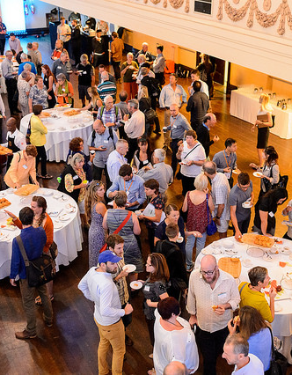
Almost half of the respondents are keen to participation in the development of a local microgrid.
The first three words that came to mind to respondents when thinking about increasing renewable energy generation in the Heyfield region for a microgrid installation were:
Community, Affordability, Environment
Independent, Improvement, Encouraging
Cheaper, Reliable, Employment for Local People
Fantastic Community Initiative
Exciting, Leaders, Forward Thinking
Really Good Idea
Ethical, sustainable, independent
Use less power from grid
Money saving, jobs, helping Heyfield
Source: C4CE. Community Energy Congress 2017

Slide 21
Heyfield draws on a history of local engagement in sustainability initiatives and great awareness of environmental issues and is keen to pursue new innovative ideas.
After previous successes with sustainability initiatives, the community is keen to pursue new innovative energy ideas to reap further benefits.
A community microgrid has the potential to bring local economic, social and environmental benefits. However, it requires a commonly-held vision that can provide guidance for future action.
The majority of responses from both the interviews and the survey indicate a strong enthusiasm for a localised energy transition, for making electricity more affordable and clean.
The initial community consultation identified the following shared vision:
“Heyfield will demonstrate the great economic benefits of locally produced and distributed clean energy in a way that empowers its community and provides cheaper electricity for all community members. Through establishing a locally owned renewables powered microgrid, the town will contribute to the national and international efforts to protect the environment. Heyfield will become independent from the main grid with a reliable and effective local electricity supply, while increasing its resilience in times of natural disasters.”
Heyfield is situated at the edge of the grid, which is also reflected in the experience of the community. With almost half of the respondents having brown or blackouts at least twice a year (or as many as ten times a year), energy reliability is a key concern.
The survey revealed a strong motivation to act on climate change and help to reduce global emissions. Cost reduction, local jobs and local economic added value are also important drivers for the interviewees in particular for a microgrid installation.
Strong local support for renewable energy is a key finding of our initial engagement with the community. A majority of people surveyed would like to see their town powered by 100 per cent renewable energy, assuming it is technically feasible and cost effective.
There is broad community interest for being actively engaged in the future planning of a microgrid project with widespread support for a variety of clean energy technologies. Solar farms, rooftop solar, and community batteries were the most preferred, while wind, biomass and hydro energy are also considered as integral parts of the picture.
“Renewable energy have a number of health and environmental benefit, no greenhouse gas emissions from fossil fuel, reduced air pollution, thus reducing dependence on imported fuels, renewable energy also help conserve the nation’s natural resources”,
Anonymous health professional from Heyfield

Slide 22
Community Engagement Plan
My
Town
Microgrid

Slide 23
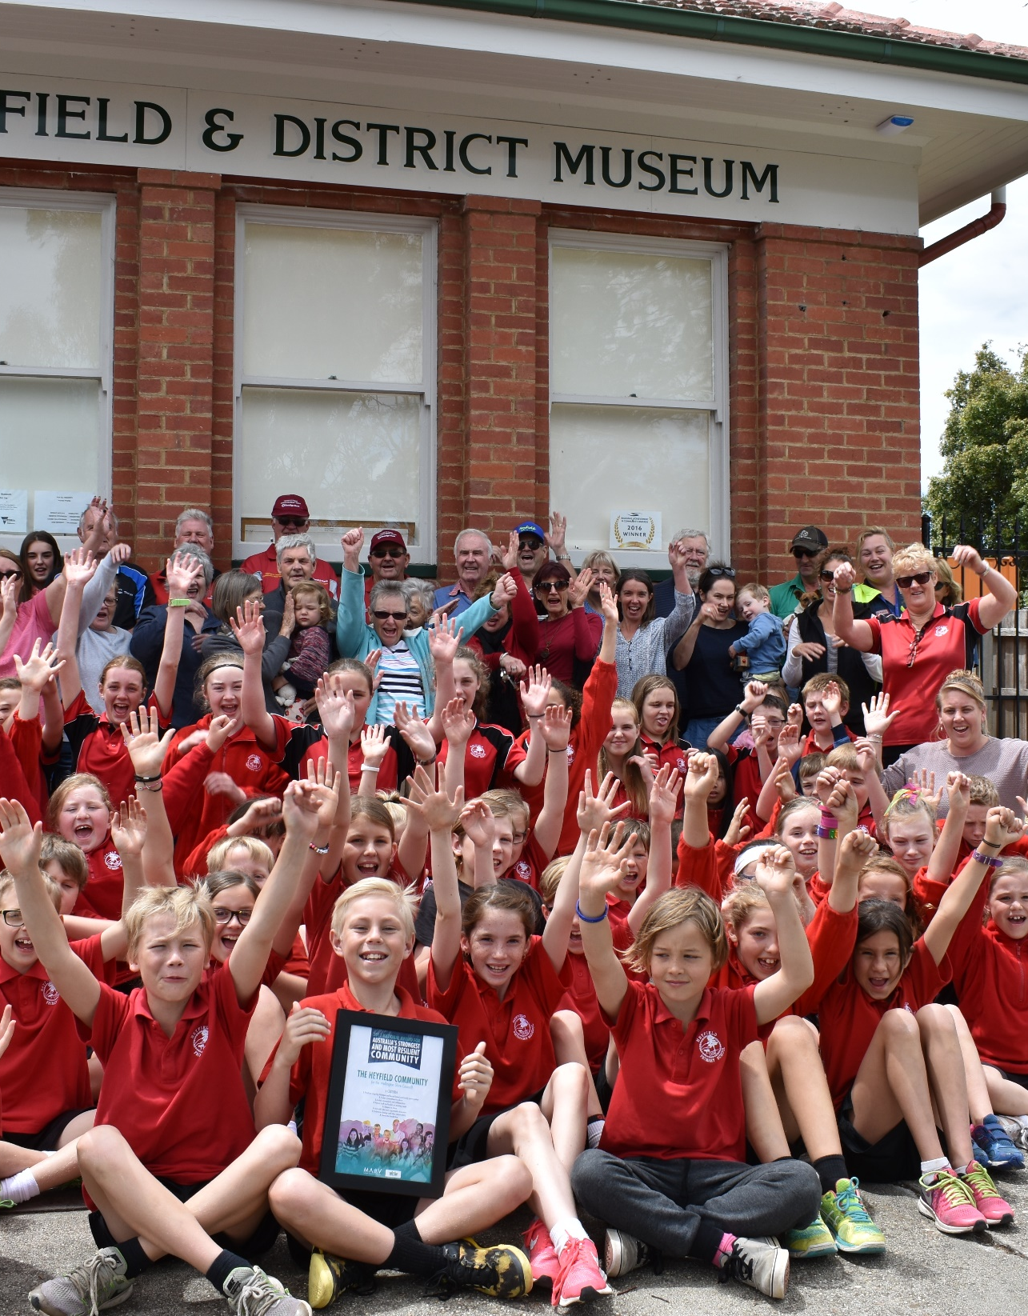
4. Community Engagement Plan
Community participation includes the promise that the public’s contribution will influence the decision-making
The objectives of this Community Engagement Plan (CEP) are to:
Introduce the project idea for a community microgrid and the Feasibility Study proposal to the Heyfield community more broadly;
Identify key stakeholders for the project implementation;
Outline the different engagement and communications methods planned to inform and engage the local community and local stakeholders for the project development;
Help to ensure local community has an opportunity to contribute to the project concept development.
The CEP is written for the Heyfield community members interested in the MyTown Microgrid project idea. Ultimately, the CEP aims for a transparent documentation to build trust and participation in the process of developing a local microgrid.
This plan is a live document and will evolve as the project is underway. The community is encouraged to contribute and input into the plan to ensure their needs, visions and requirements are reflected and adequately addressed in the local context.

Slide 24
Spectrum of Participation
Those who are affected by a decision have a right to be involved in the decision-making process
Aspiring to deliver best practice our community engagement plan refers to the International Association for Public Participation – Spectrum for Participation. Our approach of community engagement activities for the MyTown Microgrid Feasibility Project are drawn from the “Collaborate” and “Empower” end of the participation spectrum.
INCREASING IMPACT ON THE DECISION
 | Inform | Consult | Involve | Collaborate | Empower
Public participation goal | To provide the public with balanced and objective information to assist them in understanding the problem, alternatives, opportunities and/or solutions. | To obtain public feedback on analysis, alternatives and/or decisions. | To work directly with the public throughout the process to ensure that public concerns and aspirations are consistently understood and considered. | To partner with the public in each aspect of the decision including the development of alternatives and the identification of the preferred solution. | To place final decision making in the hands of the public.
Promise to the public | We will keep you informed. | We will keep you informed, listen to and acknowledge concerns and aspirations, and provide feedback on how public input influenced the decision. | We will work with you to ensure that your concerns and aspirations are directly reflected in the alternatives developed and provide feedback on how public input influenced the decision. | We will look to you for advice and innovation in formulating solutions and incorporate your advice and recommendations into the decisions to the maximum extent possible. | We will implement what you decide.
Source: https://iap2.org.au/

Slide 25
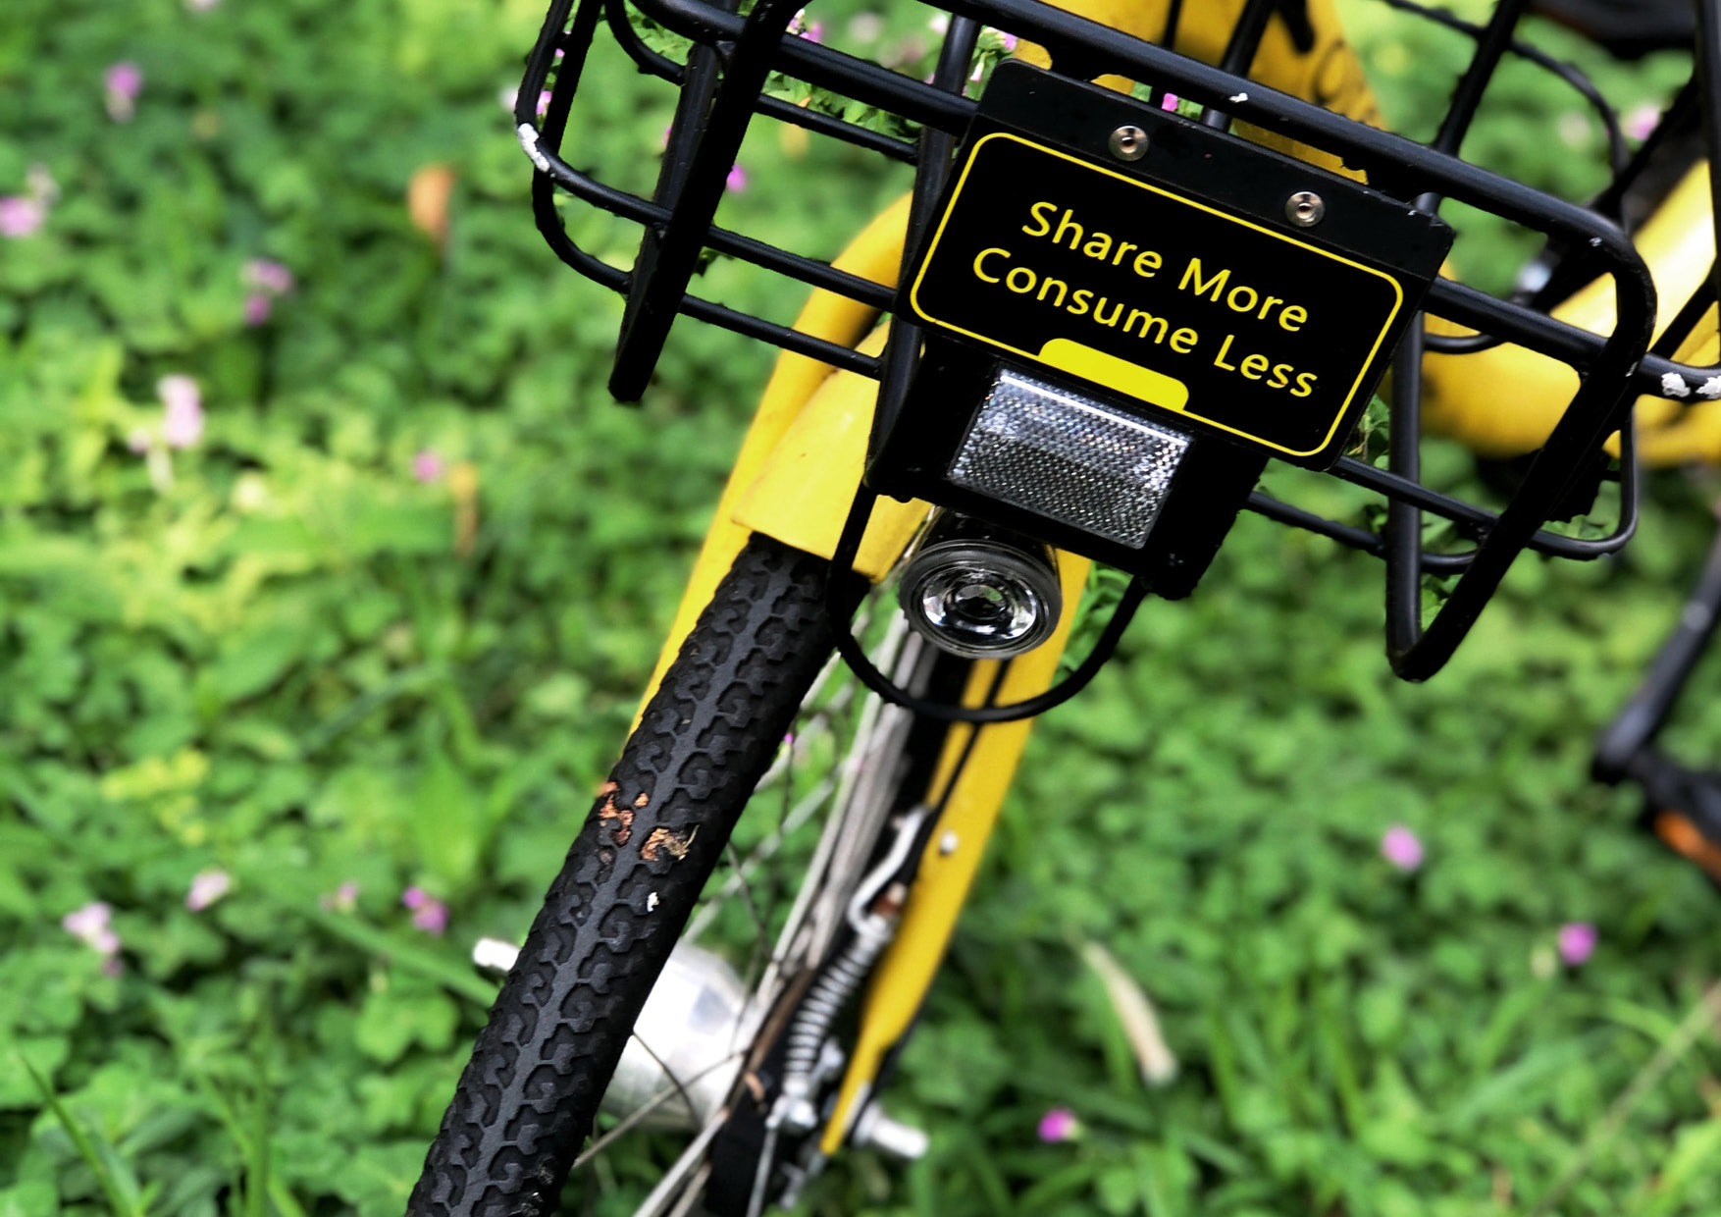

High level of volunteerism, being familiar with the sustainability work of the HCRC and because the participants consistently reported that Heyfield had a strong community spirit
Why is Heyfield ideal for a local microgrid project?

Slide 26
4.1 Stakeholder Mapping
An initial assessment of key stakeholder groups has been conducted through desktop research and interviews with key community members. The stakeholder mapping is to ensure that community members who are interested in or possibly impacted by the project are identified early. Table below outlines the identified stakeholder groups so far. The stakeholder group table will be updated as the project proceeds and the community provide feedback on its completeness.
Stakeholder Group | Description
Heyfield Community Resource Centre | Julie Bryer, Caroline Trevorrow, Amanda Goodge
Local Business | Australian Sustainable Hardwood (ASH) IGA Bakery Timberline General Store Mobil Supa Truss Thomson Valley Service Centre Local Electricians Local Solar Installers – Ian Martin Farmers – Agriculture Industry Group(s) Valley Fire & Security
Schools, TAFEs | St. Michael’s Primary School; Heyfield Primary School
Hospital | Heyfield Hospital
Other community services/ organisations | Heyfield Memorial Hall Heyfield Bowls Club Rotary/Lions Club Wetland Centre
Council | Wellington Shire Council: Joanna Rule Sustainability and Compliance Officer
Councillors (Northern Ward) | Malcolm Hole; Carolyn Ann Crossley; Carmel Ripper
Latrobe Valley Authority | Moragh Mackay
State MP | Tim Bull
Federal MP | Darren Chester MP
“In a changing and warming climate Heyfield has the chance to be a community leader in renewable energy. We must seek change from the ground up for the future of our plant.”
Anonymous, community member of Heyfield

Slide 27
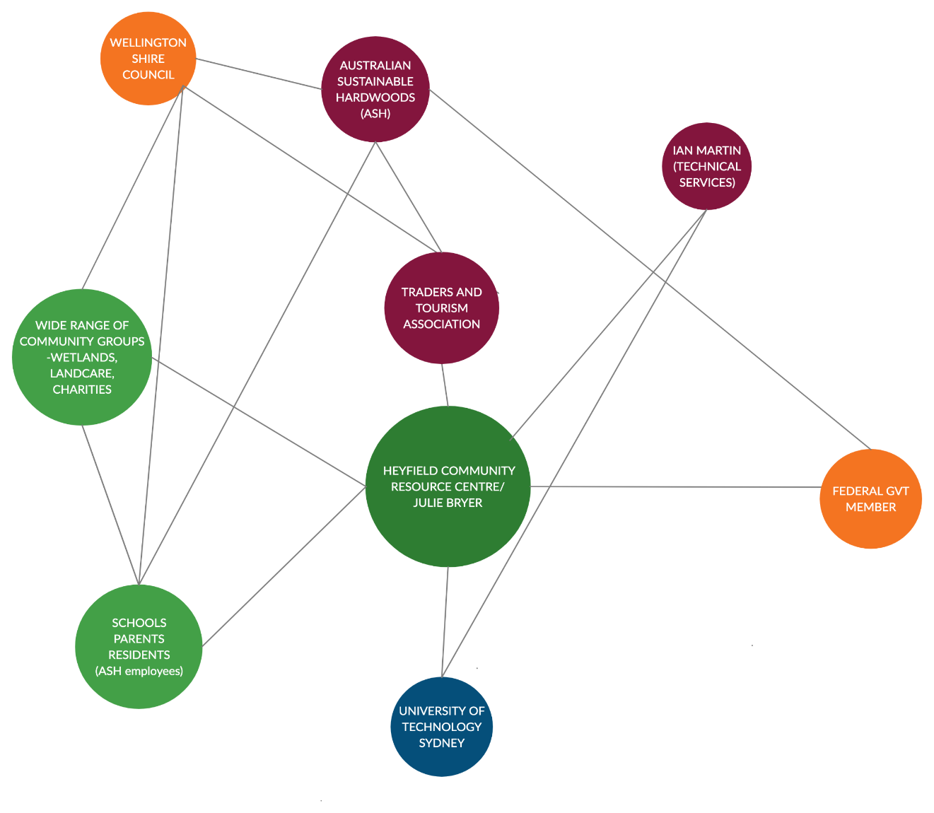
Heyfield Microgrid Network Map
There are a number of stakeholders that could and should be involved in the development of the microgrid project. The illustration below maps out informal groups that might be involved in a microgrid project

Slide 28
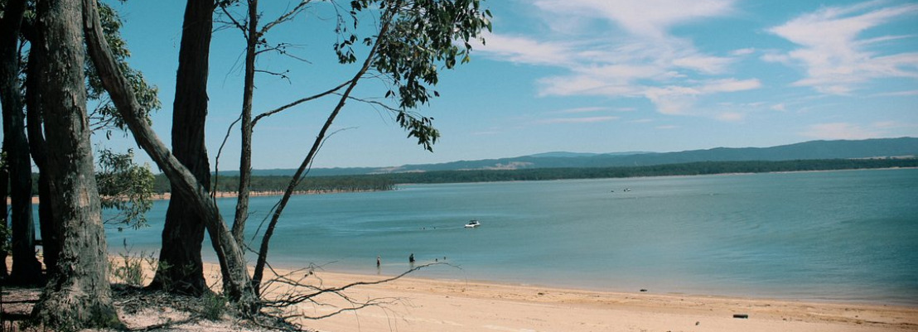
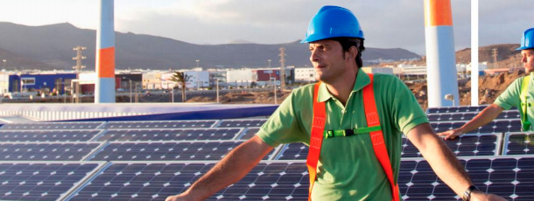
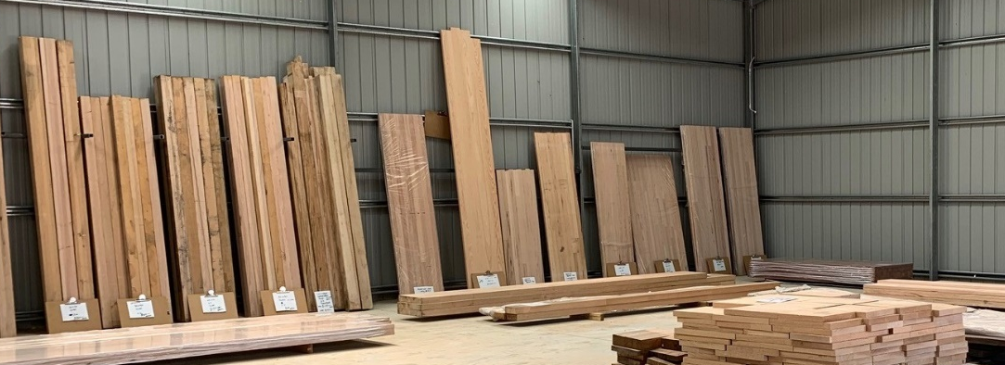
Key Stakeholder Groups and Attitudes
Households and local businesses are driving the solar rooftop revolution in Heyfield
Local Community Organisations
Heyfield Community Resource Centre is the driving force behind the project activities keen to see further sustainability initiatives implemented in town.
Further local community organisations such as the local Fire Brigade, Wetland Centre and Heyfield Bowls Club, Rotary/Lions Club will be instrumental in distribution project information and involving the community. They are also likely to benefit from the project implementation.
Local Government
Wellington Shire Council encourages and supports local sustainability initiatives. There are a number of large-scale renewable projects proposed for the region, yet still pending planning approval. Interviewees from council recognise the great success of the Heyfield community in regard to household solar deployment.
There is great a opportunity for Council to participate in the project development and implementation while telling the story and inspire other local communities in their local government area.
Local Business
A large number of businesses have emphasised their support for the project idea those include ASH and IGA.
There are also local energy businesses such as electricians and solar installers.
They are motivated by potential benefits such as reduced electricity costs and more reliable electricity supply, as well as potential local orders. Businesses can be instrumental in the implementation providing local infrastructure and land for renewable energy deployment.
Latrobe Valley Authority
The Latrobe Valley Authority (LVA) is a government body founded in November 2016 in response to the sudden closure of Hazelwood Power Station. Since then they worked in partnership with local businesses and community members on projects to transition the local economy and community towards a sustainable future.
LVA supports Heyfield’s community in their vision and has funded the prefeasibility stage of a microgrid project in Heyfield.
State Government
The Victorian State Government demonstrates great leadership in renewable energy deployment, having set a Renewable Energy Target (VRET) of 50 per cent by 2030. To realise this target the state government is taking a multifaceted approach. It includes support for both large- (Renewable Energy Auction Scheme) and small- to medium scale projects (Solar Homes Program and Community Power Hub Program) and incentives for new job creation and investments (New Energy Jobs Fund) in clean energy sector as well as broader industry engagement (Take2 pledge program).
Local Opposition
While there is great support for renewable energy, conversations with community members indicate a community division and some potential local opposition towards solar or wind farm developments. It is important to understand and try to address their concerns while communicating about the project steps in a transparent and open way.

Slide 29
Engagement audiences and actions
HIGH INFLUENCE – LOW PARTICIPATION
(EG GOVERNMENT)
ACTION: KEEP INFORMED
HIGH INFLUENCE – HIGH PARTICIPATION
(EG RENEWABLE ENERGY FOCUSED LOCAL COMMUNITY GROUPS, BUSINESSES)
ACTIONS: ONGOING ENGAGEMENT AND COMMUNICATION
LOW TO NEGATIVE INFLUENCE – LOW FORMAL PARTICIPATION
(EG LOCAL COMMUNITY, BUSINESSES UNINTERESTED IN RENEWABLE ENERGY, OR WHO PREFER FOSSIL FUELS)
ACTIONS: MONITOR, INFORM AND ENGAGE
LOW INFLUENCE – HIGH PARTICIPATION
(EG RESIDENTS, TECHNICAL EXPERTS)
ACTIONS: ONGOING ENGAGEMENT AND COMMUNICATION

Slide 30
4.2 Engagement Activities
In the Prefeasibility Study different avenues for engagement and participation have been identified to maximise the positive flow on effects of the project in as many ways as possible. The table below provides an overview of these avenues to be conducted as part of the Feasibility Project with the purpose to involve the community in co-developing a local microgrid. The activities are not in order of execution, though they provide an indication of the temporal succession.
 | Purpose | Target Group | Details
One on one meetings (targeted) | One-on-one meetings will be held to discuss more detailed aspects of the approach and share relevant information and feedback. And to agree on future engagement methods. | Local businesses, Local Council (planners, sustainability staff, senior management), LVA and other government agencies | Contact key stakeholders to arrange meeting times & to source any relevant documents. Have small meetings of 3-4 people and also invite them to do other activities as appropriate.
Local project contact | A local project contact (Community Liaison Officer) for on‐ground and networking, consulting and engaging with community organisations, community representatives, media representatives and residents to ensure a high level of project integration into the region, and to a provide regular and proactive contact point for local stakeholders. | All community | A dedicated person based at HCRC working for a couple of hours per week.
Townhall event | To publicly launch the project, introduce the project steps and ways of participation to a broad audience, and have another chance to listen and answer questions. | All community, by open invite | It will involve a large communications/media push to launch project incl. email introduction, fact sheets, FAQ, media articles.
Street survey (optional) | To access information & input from a large number & a diverse mix of stakeholders from across the region about the project idea, identify volunteers for reference group and community prospects for data collection. Surveys will be done at different points in time (beginning, middle, end of project) to chart how people’s attitude change over time. | All community, open invite | Focus will be on street survey approach, and providing forms through HCRC as well as online (e.g. google forms) to gain input on vision, concerns and challenges associated with microgrid idea, and identify community members for reference group and data collection.

Slide 31
Engagement Activities (continued)
 | Purpose | Target Group | Details
Establish community reference group | Community reference group will be upskilled on project details (technical and legal aspects) and should contribute to the project development, provide advice and input regarding community preferences and local context. The group is also to network and share the project details and help build local support for the project. | All community to select volunteers | Identify volunteers to join the project reference group and set up regular meetings (monthly/ bi-monthly basis). Invite experts e.g. from other communities working on similar projects e.g. Yackandandah.
Visioning workshops | Two visioning workshops will bring a diverse mix of stakeholders together to create a shared vision for a renewable energy future for Heyfield. | All community, by open invite Particularly targeting specific organisations e.g. Council, Businesses etc. | The workshop will also allow for local TAFE students to observe the facilitation of community-led transition process.
Education offering for schools | Wattwatchers brings special designed education offering for schools for gamification of energy that integrates with the school curriculum. Students will be introduced to the decision support tools to better understand energy choices and complex opportunities. | All local schools | Wattwatchers will present the tool at selected To engage local students in the project idea and demonstrate the benefits of renewable energy.
Co-design workshops | This series of workshops are to map out the financial and legal requirements for a microgrid project, share research outcomes (business model scan) and co-design the fine details of a business model for a local microgrid. This process should ensure the community can make an informed decision about the future of a local microgrid development. | Selected community members by invite
Public project close | Celebrating the project finalisation and share the outcomes with the community. | All community, by open invite | Present achievements and next steps for implementing the microgrid.

Slide 32
4.3 Communication Strategy
A comprehensive description of each of the communication methods are presented below. The selection of communication methods also reflects the preferred way of contact as stated by respondents in the community survey.
Methods | Purpose | Target Group | Details
Emails and Newsletter | To distribute general project information, updates and invitations to participate in e.g. events, workshops and surveys. | Selected community members and wider Heyfield community | Personal emails from project team, a dedicated online newsletter for the project as well as HCRC promoting the project through Heyfield News. Majority of respondent identified the newsletter as their most preferred method to learn more about the project. Indeed the reach of the weekly newsletter is great with 40 online copies and 350 printed copies distributed around town, it is also laid out at local businesses and community organisations.
Posters, postcards and flyers | Posters, flyers and postcards are used to inform about the project and advertise events and other public activities. | Heyfield community and broader region | These material will distributed at key locations in town such as public services, cafes, notice boards, hairdresser etc. The HCRC is a central meeting point in town and will play an important role for distributing project relevant information. Survey respondents emphasised that visits at HCRC are a key source and exchange of information.
Facebook | Set up dedicated Facebook page for the project from which social media posts can be distributed. The page should be linked and promoted by local businesses, community organisations etc. to reach as many people in the area as possible. | All community | Using social media for engaging with community members in a easy to access way (e.g. using their phones) aiming for project updates once per week. Social media ranked third as communication method. HCRC experience’s with Facebook also indicate it as a great communication tool reaching a diversity of age groups.
Website | Platform to share detailed information about the project and outcomes, participation opportunities, announcement of events, provide contact information | All community and beyond | A standalone website for the project hosted by HCRC or ISF. Website information was indicated as another relevant method by the survey participants.

Slide 33
Communication Strategies (continued)
Method | Purpose | Target Group | Details
Webinar(s) | Webinars might be another avenue to inform the community about the project activities and stay in touch. | All community, by open invite | Depending on the national and state wide situation in regard to the COVID-19 Pandemic related restrictions, online meetings might become necessary to engage with the community. Though, it has to be considered that this was the least preferred communication option by survey respondents.
Further communication methods
Media releases | To announce key project milestones and inform about the project’s progress and activities | Local and regional media outlets | Circulate to local and regional media outlets.
Stalls at fairs and events | A presence at fairs will help to get into informal conversation with community members and raise awareness about the project. | All community | Using HCRC stalls at events to distribute flyers, display posters and inform about project progress in conversations.
Present on local radio or other local media | Tell the story of the project in a verbal manner to connect with as many regional people as possible. | Local radio stations and TV outlets | Contact and offer the story to local and regional radio stations.
Communication methods will have to be reviewed and potentially amended based on the project arrangements.

Slide 34
Opportunities
Interviewee’s vision: Heyfield’s energy supply to be “fair, accessible, and community-driven”
While the development of microgrids presents opportunities as well as challenges, the community’s input is an important source for prioritising the next steps of the project. Drawing on the interviews and survey responses of the Prefeasibility Study a number of observations of community’s interest, needs, concerns and views have been made and translated into recommendations.
The empirical data suggest great interest and excitement about the prospect of a local microgrid installation. The following opportunities were captured:
There is considerable community appetite for participating in local sustainability initiatives. However the project initiative of a local microgrid is currently carried by very few community members. Establishing a local community energy group to catalyse, drive and own the project idea would be beneficial to help generate local support, ensure continuation, and ultimately implementation of the project.
More than half of all local businesses have rooftop solar. There is a great opportunity to include them in the development of the project.
Due to a changing local employment market new job opportunities are timely and desired. Local ownership of a microgrid installation could facilitate greater local procurement and job creation.
Involve local experts e.g. communications, legal, accountants and business professionals to provide input in the project development
Establishment of a dedicated local contact and communication person in the Feasibility stage of the project will provide consistency of messaging, continuity of staff‐stakeholder relationships and ensure maximum accessibility.
A local microgrid is understood to help reduce electricity bills. It is important to provide fair and equitable access to the benefits to all residents. This involves considering the needs of low income households and exploring the potential for cross subsidising.
There are a number of educational institutions (e.g. Primary Schools) in the region that are great platforms to mobilise for the project idea and educate on energy issues. The educational part of the project should be strengthened and collaborations with institutions established.
Medium and large-scale renewable energy projects can offer economic opportunities to local communities. Sharing the benefits through partnerships with large-scale renewable energy developers could support a strategic, long-term regional development.
Reaching out and engaging with traditional owners of the area provides an opportunity for indigenous participation and benefit sharing.

Slide 35
Challenges
“Would it be big enough to benefit all of the community's residents?”
Studies found that the majority of challenges associated with developing a microgrid speak to the socio-institutional context rather than the technology’s feasibility (Farrelly and Tawfik 2020). In the Prefeasibility Study the following concerns were captured and will need to be addressed in the Feasibility Study:
One of the most often raised concerns were costs, the potential need for government subsidies and if the electricity will remain affordable or as desired become cheaper.
Social equity and fairness are very important values to community members. Hence there is a great interest to share the benefits of the microgrid beyond the borders of the Heyfield town. Therefore the location of the microgrid is a concern since it might exclude people from other parts of town or the region e.g. Licola etc.
People felt that there is a great need for further education and information about microgrids and how it work
Although there were no questions about remaining connected to the main grid, reliability appeared as an important factor for the community which also has to be ensured through a microgrid solutions. The need for backup provision was mentioned while pointing towards battery storage.
Potential visual amenity and the placement near housing were also raised as concerns.
Some opposition towards large-scale wind farms was noticed, which emphasises the need for exploring a diversity of renewable energy while rooftop solar PV was the most preferred option in the community survey
Further question were:
How future proof is the technology?
How and who will manage and maintain the microgrid?
Would solar PV owners be compensated for feeding their electricity into the local grid?
Could the technology support Heyfield's requirements and expectations

Slide 36
7. Summary and next steps
The development of a microgrid in Heyfield offers a unique opportunity to explore the forefront of national leading community energy innovation. Heyfield can become part of a growing community movement which helps to accelerate the energy transition and ensures that the benefits are fairly distributed.
Key findings from the Prefeasibility Study are:
Great excitement and interest in the development of a local community energy project.
Some concerns were raised in regard to costs and accessibility for all community members including low income households and out of neighbouring villages
A common vision among surveyed community members emphasises economic efficiency, reliability, fair access and environmental benefits associated with renewable energy.
Establishing a local community energy group could help drive the project idea forward
As with every infrastructure development, community engagement is a prerequisite for project’s success.
This Community Engagement Plan outlines the depth of work and commitment considered for the implementation of the Feasibility study of MyTown microgrid in Heyfield. It is driven by the principles of collaborating and empowering the local community to co-design a community energy project to enable fair access and benefit sharing with the locals.
Summary of Recommendations
Establish a local community energy group
Reach out to all local businesses and engage them in the development of the project
Prepare to reach out to educational institutions and involve students from an early stage of the Feasibility Study
Explore the opportunity to collaborate with large scale renewable energy developers
Consider to reach out and actively engage with low income households to understand their needs
Prepare to address early community concerns in first stage of Feasibility study
Reach out to and engage with local indigenous groups
Next Steps
Informing the community about the outcome about the positive outcome of the grant application
Prepare the implementation of engagement plan and rally up project partners to get started

Slide 37
Endnotes - References
¹ Community Power Agency. Website: www.cpagency.org.au
² Wahlquist, Calla et al. 2020. Mothers, daughters, fathers, sons: the victims of the Australian bushfires. The Guardian. Link: https://www.theguardian.com/australia-news/2020/jan/02/mothers-daughters-fathers-sons-the-victims-of-the-australian-bushfires and WWF. 2020. Statement from WWF-Australia on Australia’s bushfire emergency. Link: https://www.wwf.org.au/news/news/2020/statement-from-wwf-australia-on-australia-s-bushfire-emergency#gs.7ucweu
³ The Australian Institute. 2020. Concern about climate escalates as bushfire crisis continues: Climate of the Nation polling. Link: https://www.tai.org.au/content/concern-about-climate-escalates-bushfire-crisis-continues-climate-nation-polling
⁴ Skarbek, Anna. 2020. Why it doesn’t make economic sense to ignore climate change in our recovery from the pandemic. The Converation. Link: https://theconversation.com/why-it-doesnt-make-economic-sense-to-ignore-climate-change-in-our-recovery-from-the-pandemic-137282
⁵ Cunningham, Michelle et al. 2019. The Changing Global Market for Australian Coal. The Reserve Bank of Australia. Link: https://www.rba.gov.au/publications/bulletin/2019/sep/the-changing-global-market-for-australian-coal.html
⁶ AEMC. 2020. Updating the regulatory frameworks for distributor-led stand-alone power systems. Link: https://www.aemc.gov.au/market-reviews-advice/updating-regulatory-frameworks-distributor-led-stand-alone-power-systems
⁷ Community Power Agency. Website: www.cpagency.org.au
⁸ C4CE. 2015. What is community energy? Link: https://c4ce.net.au/aboutc4ce/what-is-community-energy/
⁹ Pullins, S. 2019. Why microgrids are becoming an important part of the energy infrastructure. Electricity Journal.
¹⁰ Schot, J., & Kanger, L. 2018. Deep transitions: Emergence, acceleration, stabilization and directionality. Research Policy, 47(6), 1045–1059.
¹¹ McGowan, B. 2017. Creating the Yackandandah Community Mini Grid. Totally Renewable Yackandandah (TRY).
¹² LO3 Energy. (2019). Latrobe Valley Microgrid Feasiblity Assessment. Retrieved from https://arena.gov.au/assets/2018/05/latrobe-valley-microgrid-feasibility-assessment.pdf
¹³ McFarlane 2011
¹⁴ ABS. 2016. Census Quick Stats. Link: https://quickstats.censusdata.abs.gov.au/census_services/getproduct/census/2016/quickstat/SSC21170?opendocument
¹⁵ Ibid.
¹⁶ Interview with a Heyfield community member.
¹⁷ ABS. 2016. Census Quick Stats. Link: https://quickstats.censusdata.abs.gov.au/census_services/getproduct/census/2016/quickstat/SSC21170?opendocument
¹⁸ Australian Sustainable Hardwood. 2020. Website. Link: https://vicash.com.au/about-us/

Slide 38
Endnotes – References (continued)
¹⁹ ABS. 2016. Census Quick Stats. Link: https://quickstats.censusdata.abs.gov.au/census_services/getproduct/census/2016/quickstat/SSC21170?opendocument
²⁰ Victorian Electoral Commission. 2020. State Election Results 2018. Link: https://www.vec.vic.gov.au/Results/State2018/Summary.html
²¹ The Clean Energy Regulator. 2020. Website. Postcode data for small-scale installations. Link: http://www.cleanenergyregulator.gov.au/RET/Forms-and-resources/Postcode-data-for-small-scale-installations
²² SOLARGIS. 2019. Solar resource maps. Retrieved from https://solargis.com/maps-and-gis-data/download/world and Global Wind Atlas. (2019). Global Wind Atlas Website. World Bank and the Technical University of Denmark. Retrieved from https://globalwindatlas.info
²³ The Clean Energy Regulator. 2020. Website. Postcode data for small-scale installations. Link: http://www.cleanenergyregulator.gov.au/RET/Forms-and-resources/Postcode-data-for-small-scale-installations
²⁴ Australian PV Institute. 2020. Website. SunSpot. Retrieved 30 May 2020, from http://pv-map.apvi.org.au/sunspot and Interview with Council representative
AEMC. 2020. Updating the regulatory frameworks for distributor-led stand-alone power systems. Link: https://www.aemc.gov.au/market-reviews-advice/updating-regulatory-frameworks-distributor-led-stand-alone-power-systems
²⁵ The Clean Energy Regulator. 2020. Website. Postcode data for small-scale installations. Link: http://www.cleanenergyregulator.gov.au/RET/Forms-and-resources/Postcode-data-for-small-scale-installations
²⁶ Vorrath, Sophie. 2019. Plans floated for $1.2bn, 550MW Gippsland solar and battery “energy park” Reneconomy Website. Link: https://reneweconomy.com.au/plans-floated-for-1-2bn-550mw-gippsland-solar-and-battery-energy-park-14012/
²⁶ Star of the South. 2020. Website. About the project. Link: http://www.starofthesouth.com.au/the-project

Slide 39
Appendix – Community Survey
What is her/his age group?
15-25
26-35
36-45
46-55
56-65
65+
What is his/her gender?
Female
Male
Prefer not to say
Where do you live?
Heyfield
Tinamba
Seaton
Glenmaggie
Cowwarr
Winnindoo
Nambrok
Other, please specify
What best describes your affiliation with Heyfield? Please tick one or more.
Local resident
Local business owner
Local government representative
Landcare
Heyfield Senior Citizens
Heyfield Community Representatives Group
Heyfield Traders and Tourism Association
Sporting clubs
RSL/Senior Citizens
Men’s Shed
HCRC
Health workers
Heyfield Lions
Rotary clubs
Other, please specify ….
How important to you is using renewable energy that is produced in Heyfield and/or the local region?
Extremely important
Very important
Somewhat important
Not so important
Not at all important
How often does your home or business experience electricity-grid supply issues (brownout or blackout)?
Very rarely
1 or 2 times per year
2 to 5 times per year
5 to 10 times per year
More than 10 times per year
Please describe your experience (optional) _________________
Assuming it is technically feasible and cost-effective, would you like Heyfield to be:
100% powered by renewable energy
75% powered by renewable energy
50% powered by renewable energy
Other (please specify) ______________________________
Why do you think should Heyfield be powered or not be powered by renewable energy?
Short answer ________________________________________
What renewable energy technologies would you like to see being used Heyfield and its local region? (please rank; 1 is highest preference)
Rooftop solar PV for homes/ business
Solar farms
Wind energy
Small-scale hydropower
Pumped-hydro storage
Bioenergy from waste (e.g. wood, food, sewage)
Bioenergy from any source (e.g. forestry, crops)
Small scale batteries (in homes and on business premises)
Community batteries (larger batteries shared by multiple homes and business)
Other____________________________________________
____________________________________________________
Microgrids often involve renewable energy for generating electricity. What are the first three words that come to mind when thinking about increasing renewable energy generation in Heyfield region?
_____________________________________________________
Do you have concerns or think there would be any disadvantages with a microgrid in Heyfield?
Yes
No
Please list or describe your top concerns_____________
______________________________________________
______________________________________________
______________________________________________
______________________________________________
Would you change your electricity provider to purchase local renewable electricity from a local community-owned retailer?
Yes
No
Don’t know
Are you interested in learning more about microgrids?
Yes (please provide email below)
No
Don’t know
If yes, how would you like to learn more about the project? Please tick one or more.
Social media (e.g. Facebook, Twitter, Instagram)
Website
Newsletter
Visits at HCRC
Townhall events
Community workshops
Webinars
Other please specify _______________________________
Would you like to participate in planning a microgrid in Heyfield?
Yes (please provide email below)
Yes, possibly, but I need more information (please provide email below)
No
Don’t know
If you would like to stay updated about a potential microgrid for Heyfield, please provide your email address below.
Please provide email contact:____________________________
Many thanks!
We’ll let you know what we’ve learned as soon as we can.
If you like, please provide any additional comments:
1. What is her/his age group?
15-25
26-35
36-45
46-55
56-65
65+
2. What is his/her gender?
Female
Male
Prefer not to say
3. Where do you live?
Heyfield
Tinamba
Seaton
Glenmaggie
Cowwarr
Winnindoo
Nambrok
Other, please specify
4. What best describes your affiliation with Heyfield?
Please tick one or more.
Local resident
Local business owner
Local government representative
Landcare
Heyfield Senior Citizens
Heyfield Community Representatives Group
Heyfield Traders and Tourism Association
Sporting clubs
RSL/Senior Citizens
Men’s Shed
HCRC
Health workers
Heyfield Lions
Rotary clubs
Other, please specify ….
5. How important to you is using renewable energy that is produced in Heyfield and/or the local region?
Extremely important
Very important
Somewhat important
Not so important
Not at all important
6. How often does your home or business experience electricity-grid supply issues (brownout or blackout)?
Very rarely
1 or 2 times per year
2 to 5 times per year
5 to 10 times per year
More than 10 times per year
Please describe your experience (optional) _________________

Slide 40
Appendix – Community Survey
7. Assuming it is technically feasible and cost-effective, would you like Heyfield to be:
100% powered by renewable energy
75% powered by renewable energy
50% powered by renewable energy
Other (please specify) ______________________________
8. Why do you think should Heyfield be powered or not be
powered by renewable energy?
Short answer ________________________________________
9. What renewable energy technologies would you like to see being used Heyfield and its local region? (please rank; 1 is highest preference)
Rooftop solar PV for homes/ business
Solar farms
Wind energy
Small-scale hydropower
Pumped-hydro storage
Bioenergy from waste (e.g. wood, food, sewage)
Bioenergy from any source (e.g. forestry, crops)
Small scale batteries (in homes and on business premises)
Community batteries (larger batteries shared by multiple homes
and business)
Other____________________________________________
____________________________________________________
10. Microgrids often involve renewable energy for generating electricity. What are the first three words that come to mind when thinking about increasing renewable energy generation in Heyfield region?
_____________________________________________________
11. Do you have concerns or think there would be any disadvantages with a microgrid in Heyfield?
Yes
No
Please list or describe your top concerns_____________
______________________________________________
______________________________________________
______________________________________________
______________________________________________
12. Would you change your electricity provider to purchase local renewable electricity from a local community-owned retailer?
Yes
No
Don’t know

Slide 41
Appendix – Community Survey
13. Are you interested in learning more about microgrids?
Yes (please provide email below)
No
Don’t know
14. If yes, how would you like to learn more about the project? Please tick one or more.
Social media (e.g. Facebook, Twitter, Instagram)
Website
Newsletter
Visits at HCRC
Townhall events
Community workshops
Webinars
Other please specify _______________________________
15. Would you like to participate in planning a microgrid in Heyfield?
Yes (please provide email below)
Yes, possibly, but I need more information (please provide email below)
No
Don’t know
16. If you would like to stay updated about a potential microgrid for Heyfield, please provide your email address below.
Please provide email contact:____________________________
Many thanks!
We’ll let you know what we’ve learned as soon as we can.
If you like, please provide any additional comments:

Slide 42
For feedback and comments please get in touch:
Heyfield Community Resource Centre
Julie Bryer
accountants@heyfield.net
Institute for Sustainable Futures
University of Technology Sydney
Scott Dwyer
scott.dywer@uts.edu.au

